Slide 1
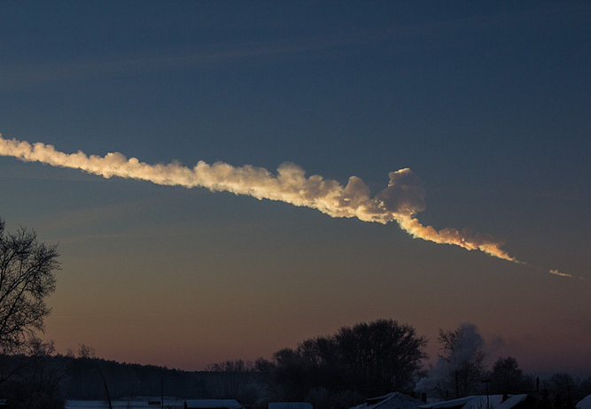
!!! TITLE
USING CLUSTERING TO IDENTIFY 3 MILLION NEW ASTEROIDS
PREPARED BY
MATT HOLMAN
PAUL BLANKLEY
RYAN JANSSEN
CS182 – ARTIFICIAL INTELLIGENCE
30 NOVEMBER 2017

Slide 2
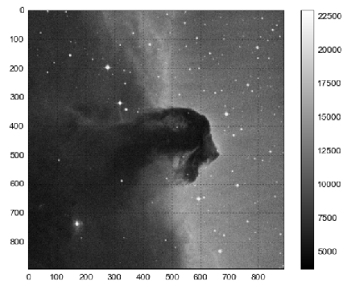

MILLIONS OF MISSING ASTEROIDS!
CONNECTING PARTIAL ASTEROID TRACKLETS
Mandate from Congress:
>90% of potentially hazardous asteroids must be tracked
Currently, we have 170m observations of known asteroids

Slide 3
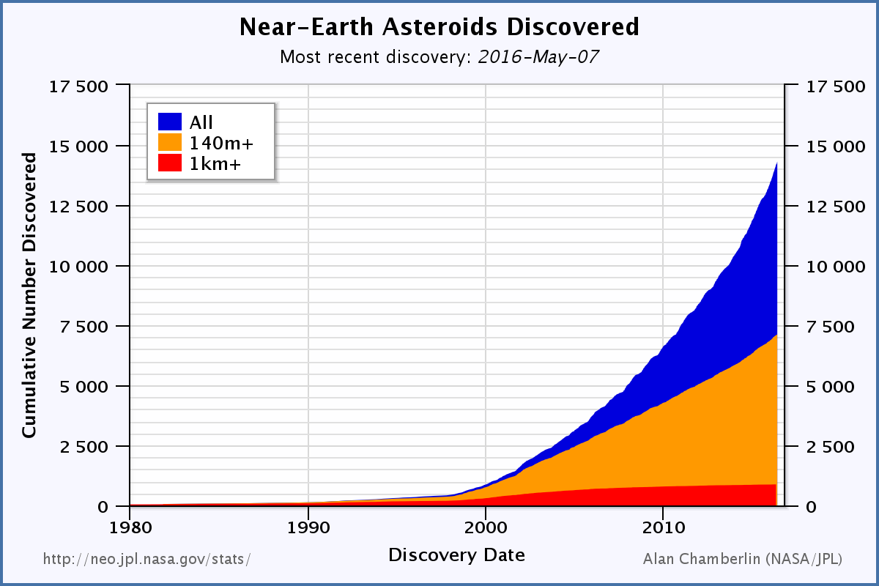
MILLIONS OF MISSING ASTEROIDS!
CONNECTING PARTIAL ASTEROID TRACKLETS
However, some observations cannot be matched into an asteroid.
There are currently:
14 million unmatched tracklets,
~3 million total asteroids.
Growing quickly as telescope resolution increases

Slide 4
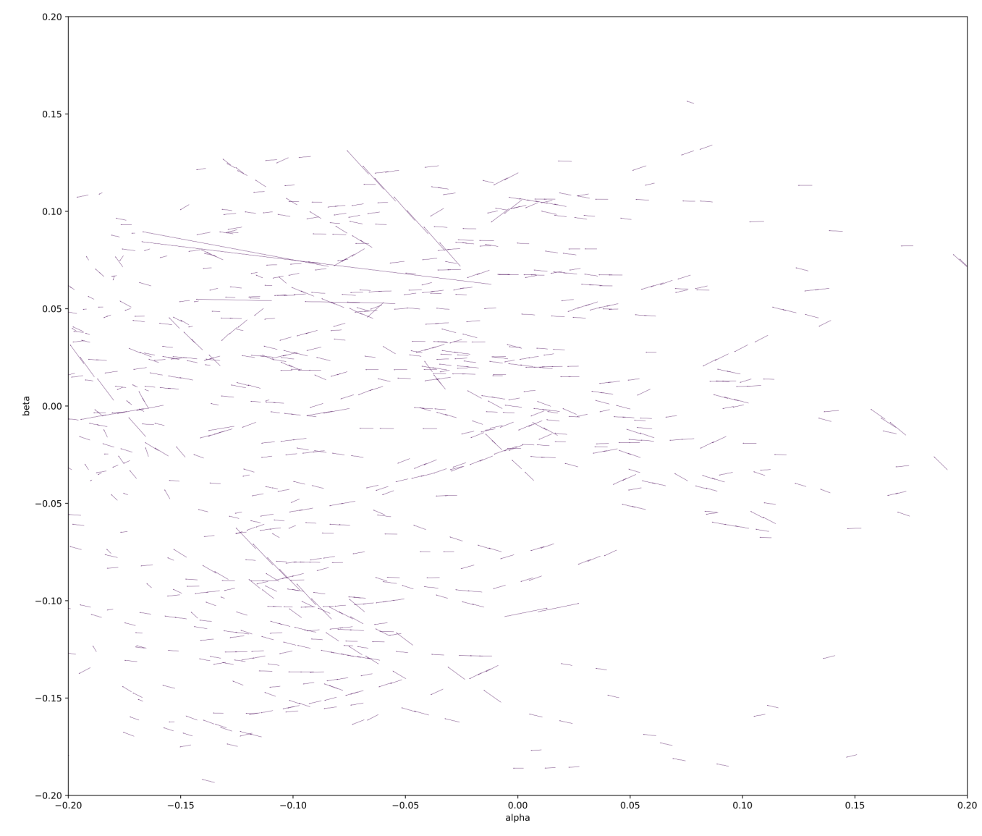

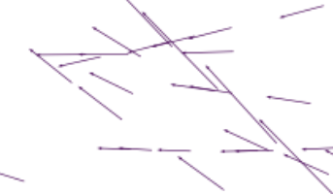
A HARD PROBLEM…
Partial asteroid tracklets (from Earth’s perspective)
High asteroid density makes clustering difficult
From Earth, asteroids trajectories are highly non-linear
Missing data (cannot tell asteroid movement/velocity in the z direction)
Sparse observations can be months or years apart
Brute force is impossible with 14m observations

Slide 5
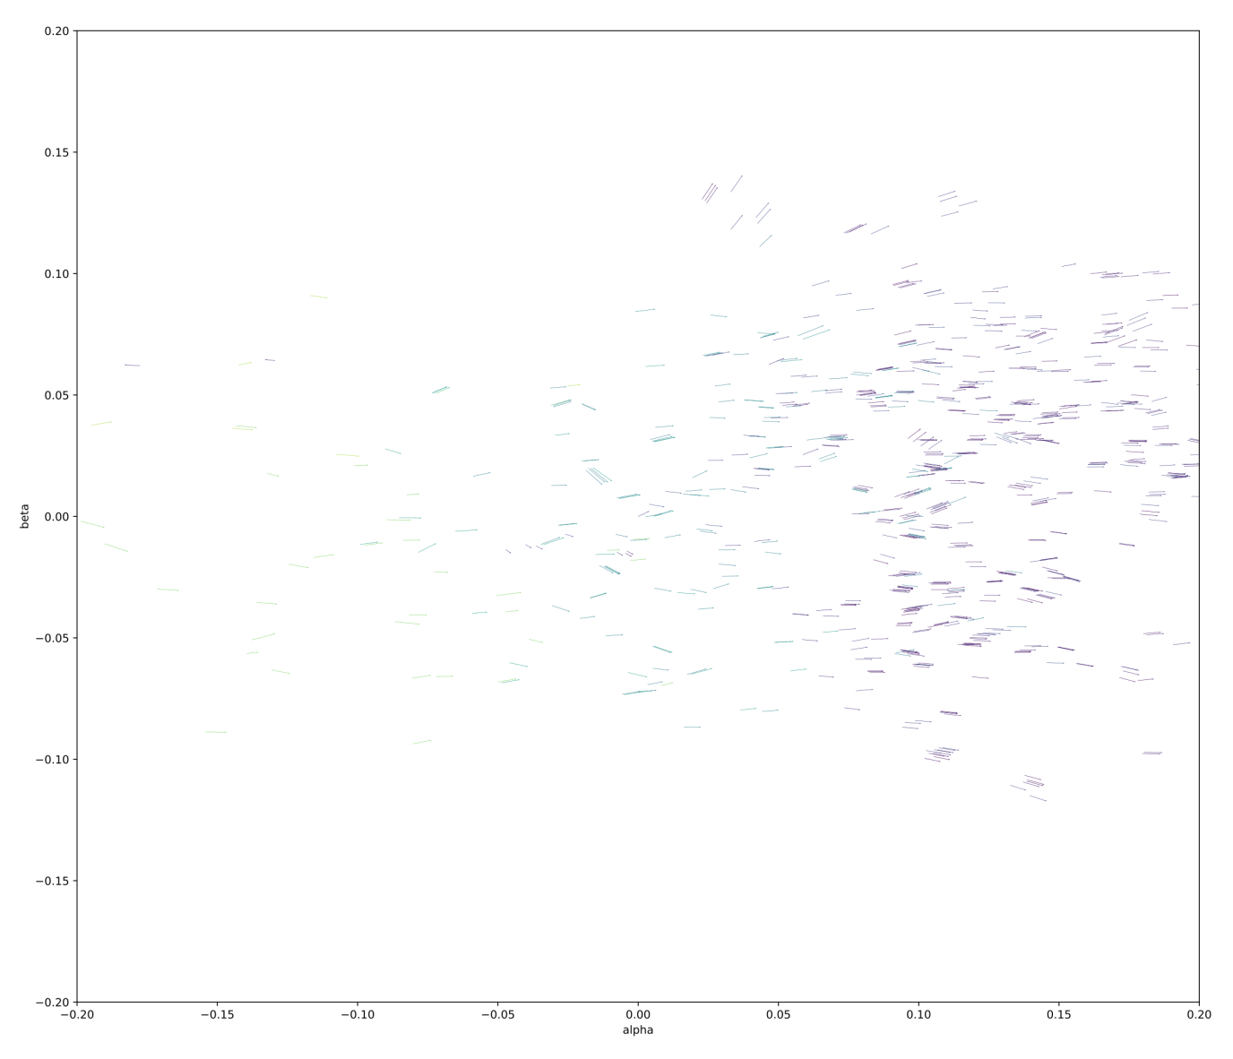
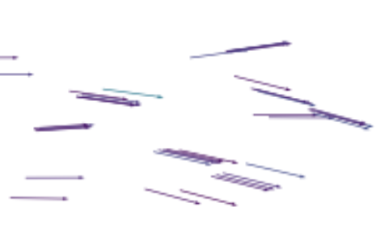
PROPOSED
SOLUTION
Partial asteroid tracklets (from the Sun’s perspective)
When we apply a heliocentric transformer, the trajectories become clear!
Similar to applying the kernel trick in 3-dimensional space
Can then set a ‘focal distance’ by inferring z-distance

Slide 6
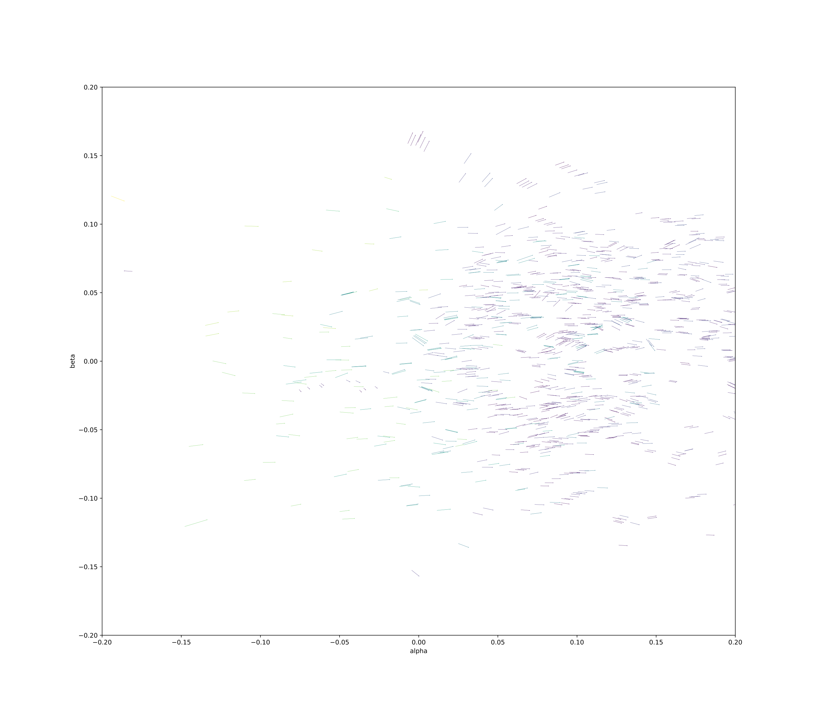
THE VIEW FROM THE SUN

Slide 7
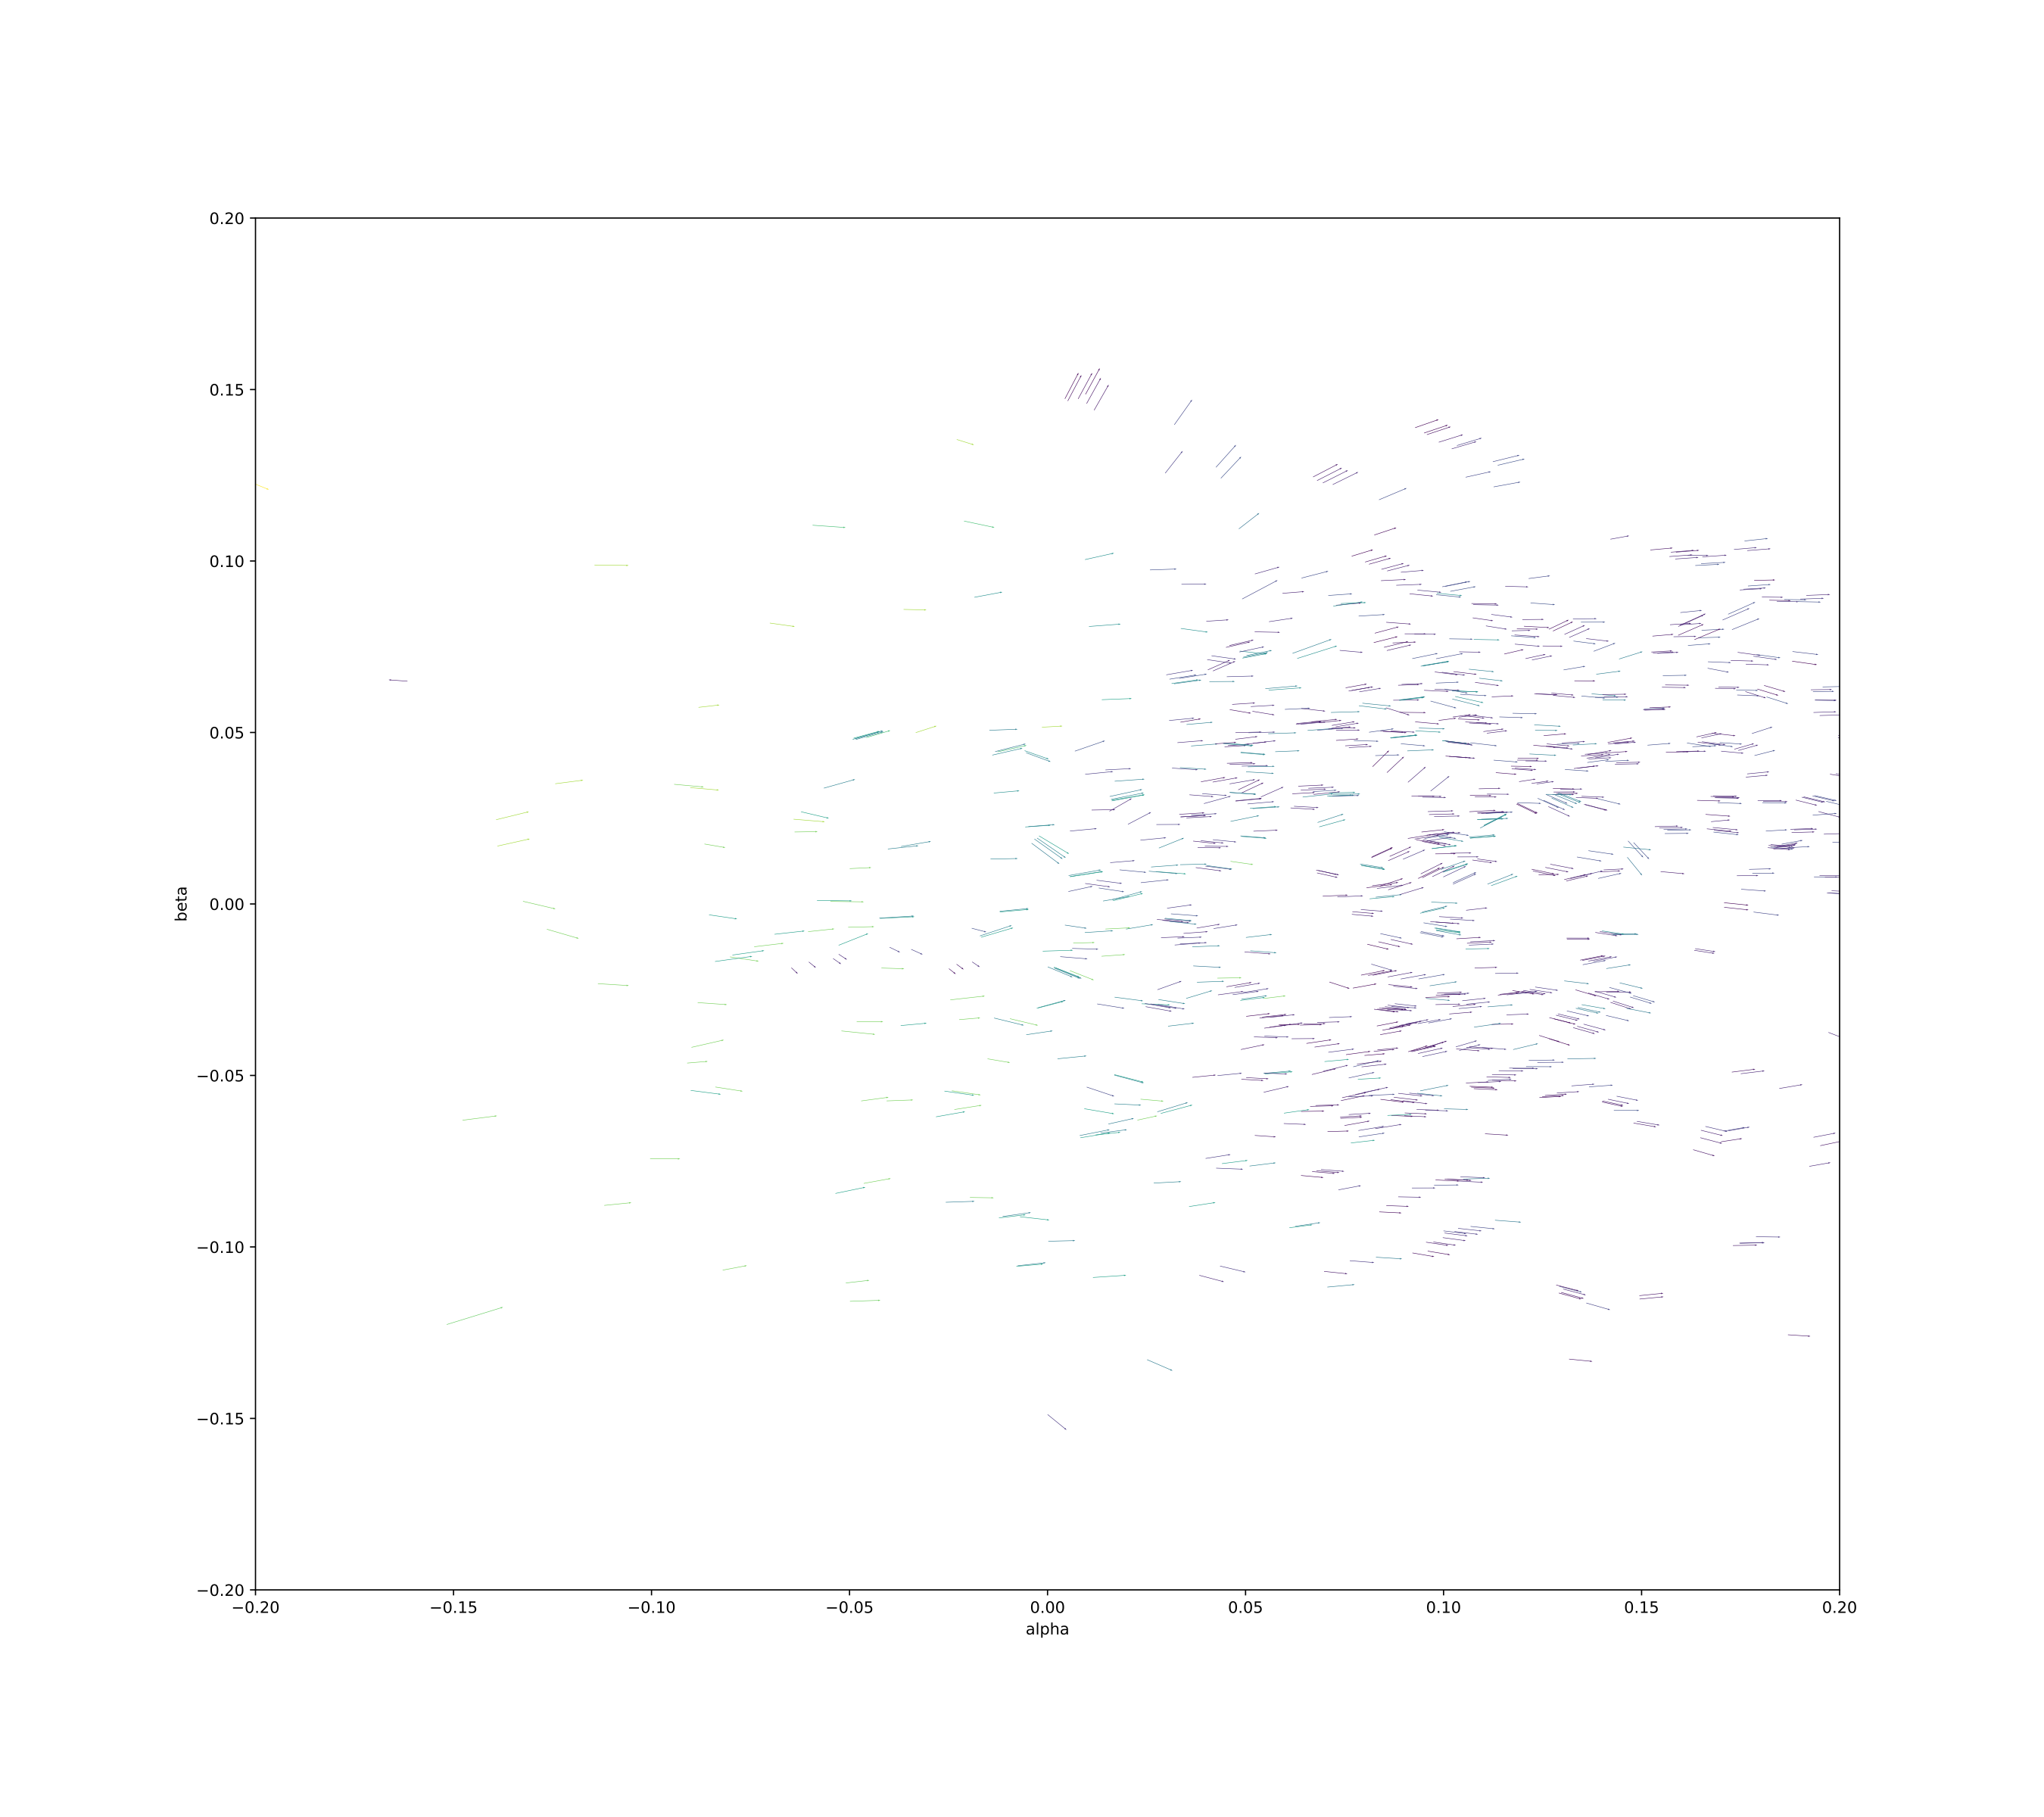
THE VIEW FROM THE SUN

Slide 8
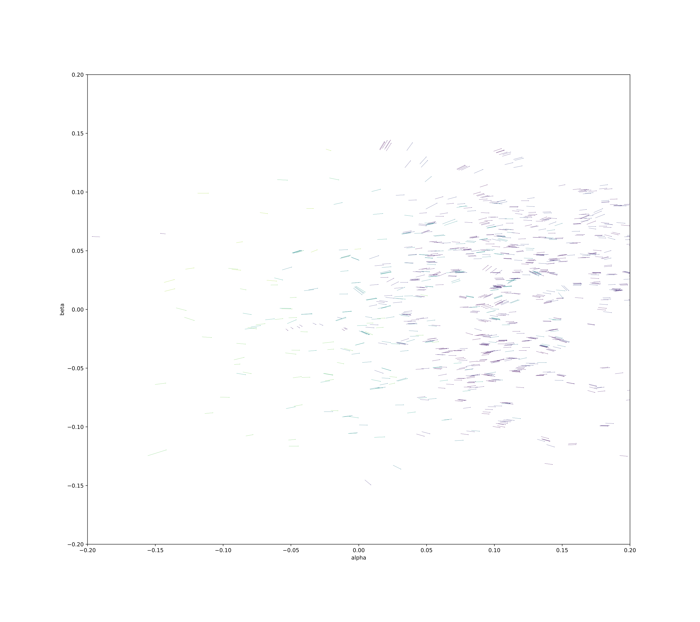
THE VIEW FROM THE SUN

Slide 9
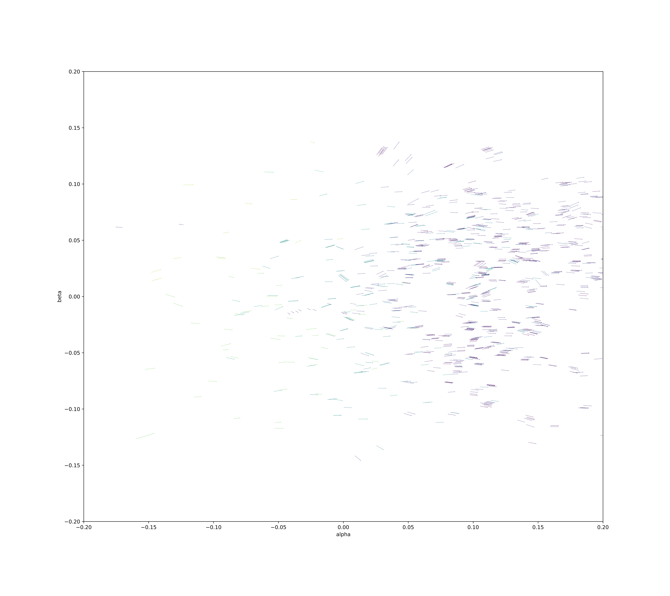
THE VIEW FROM THE SUN

Slide 10
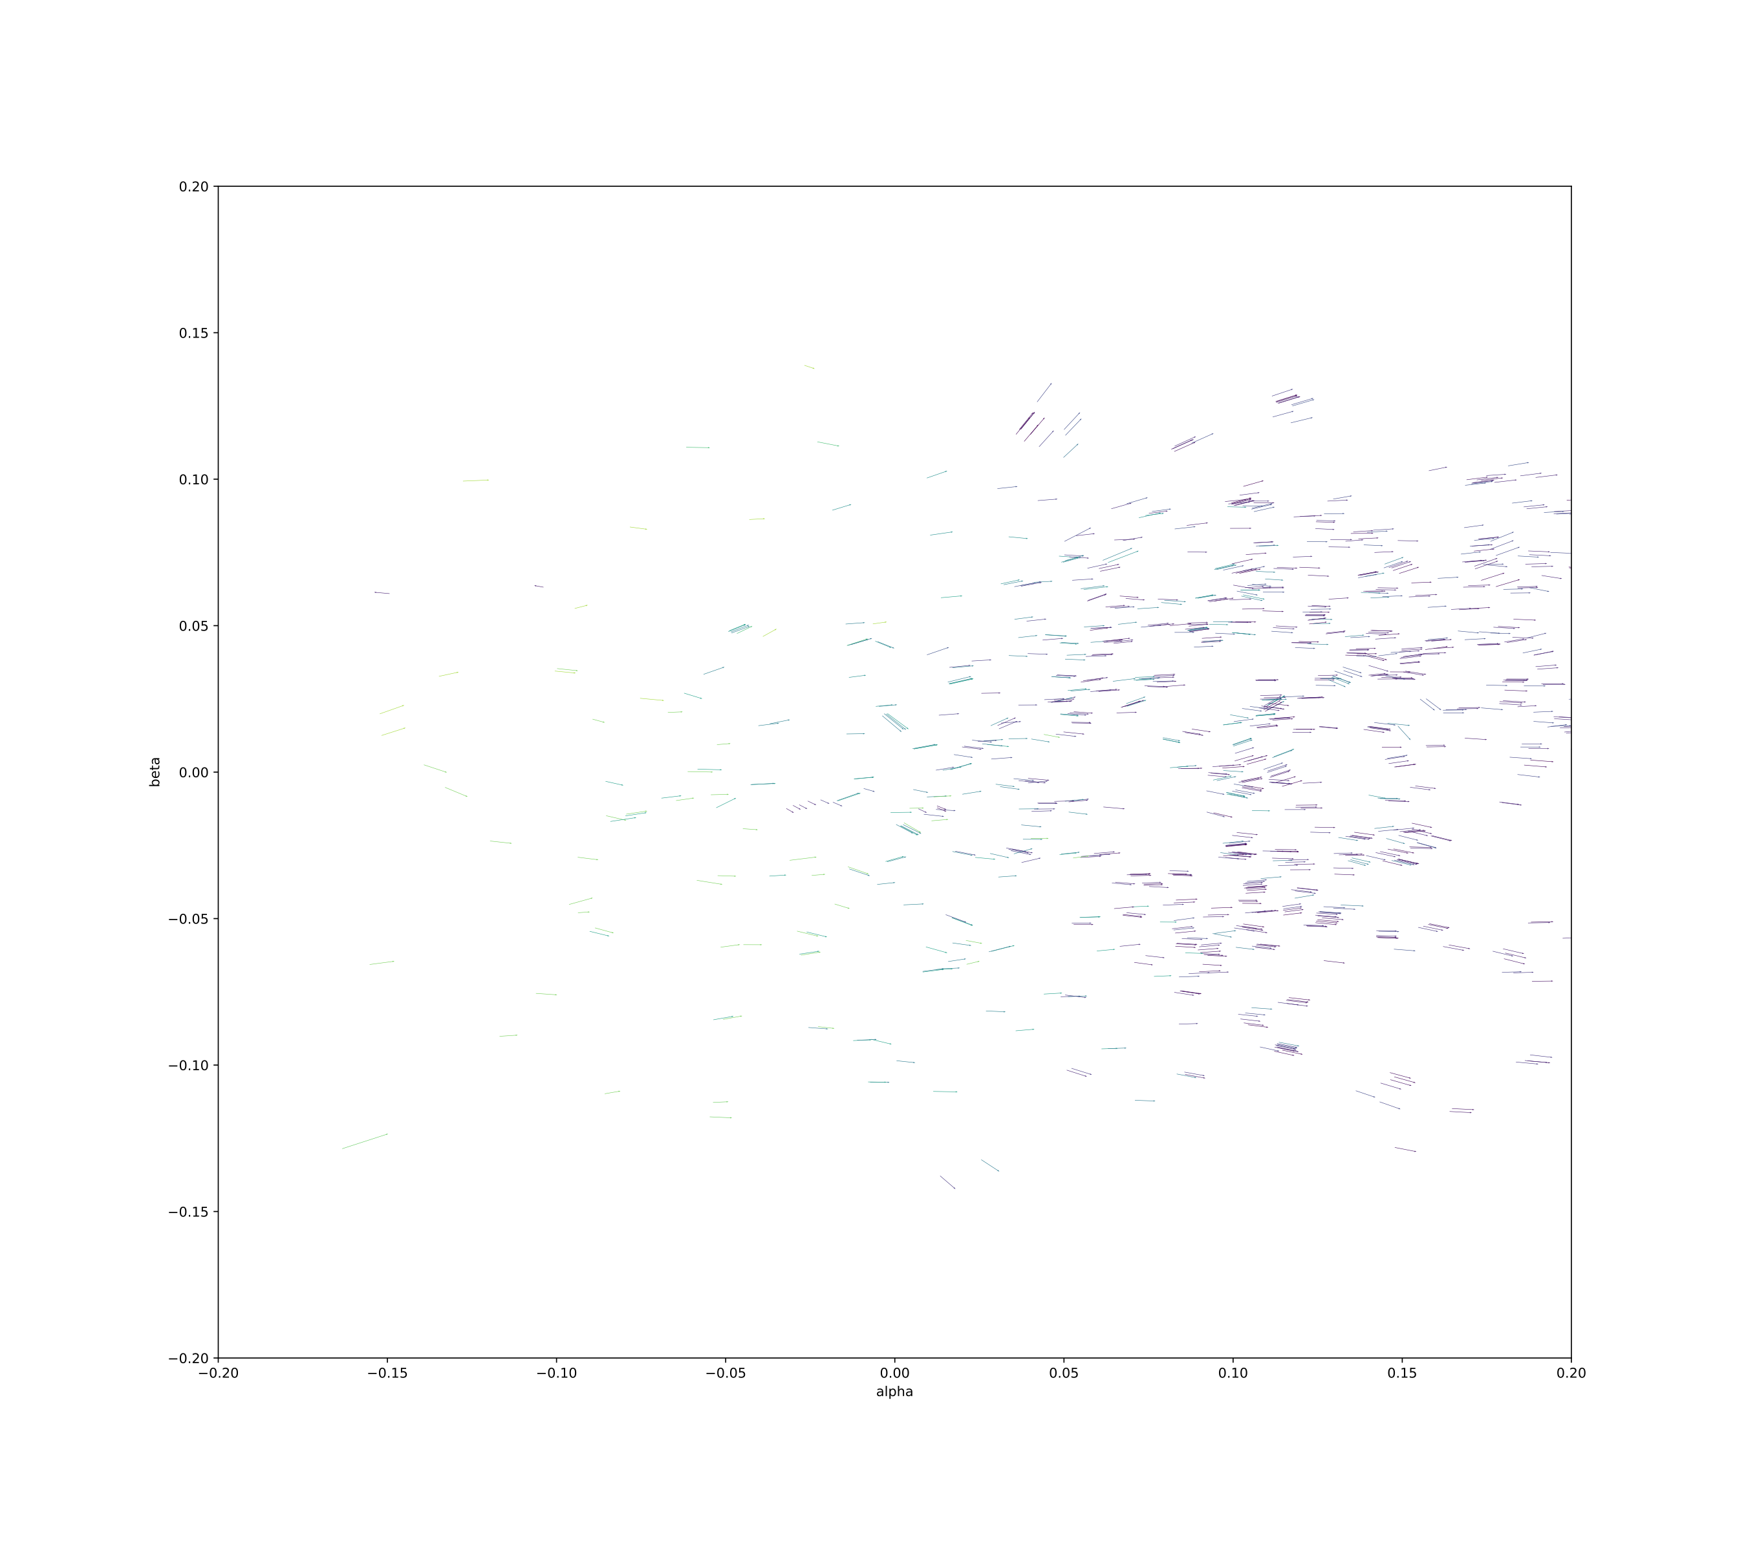
THE VIEW FROM THE SUN

Slide 11
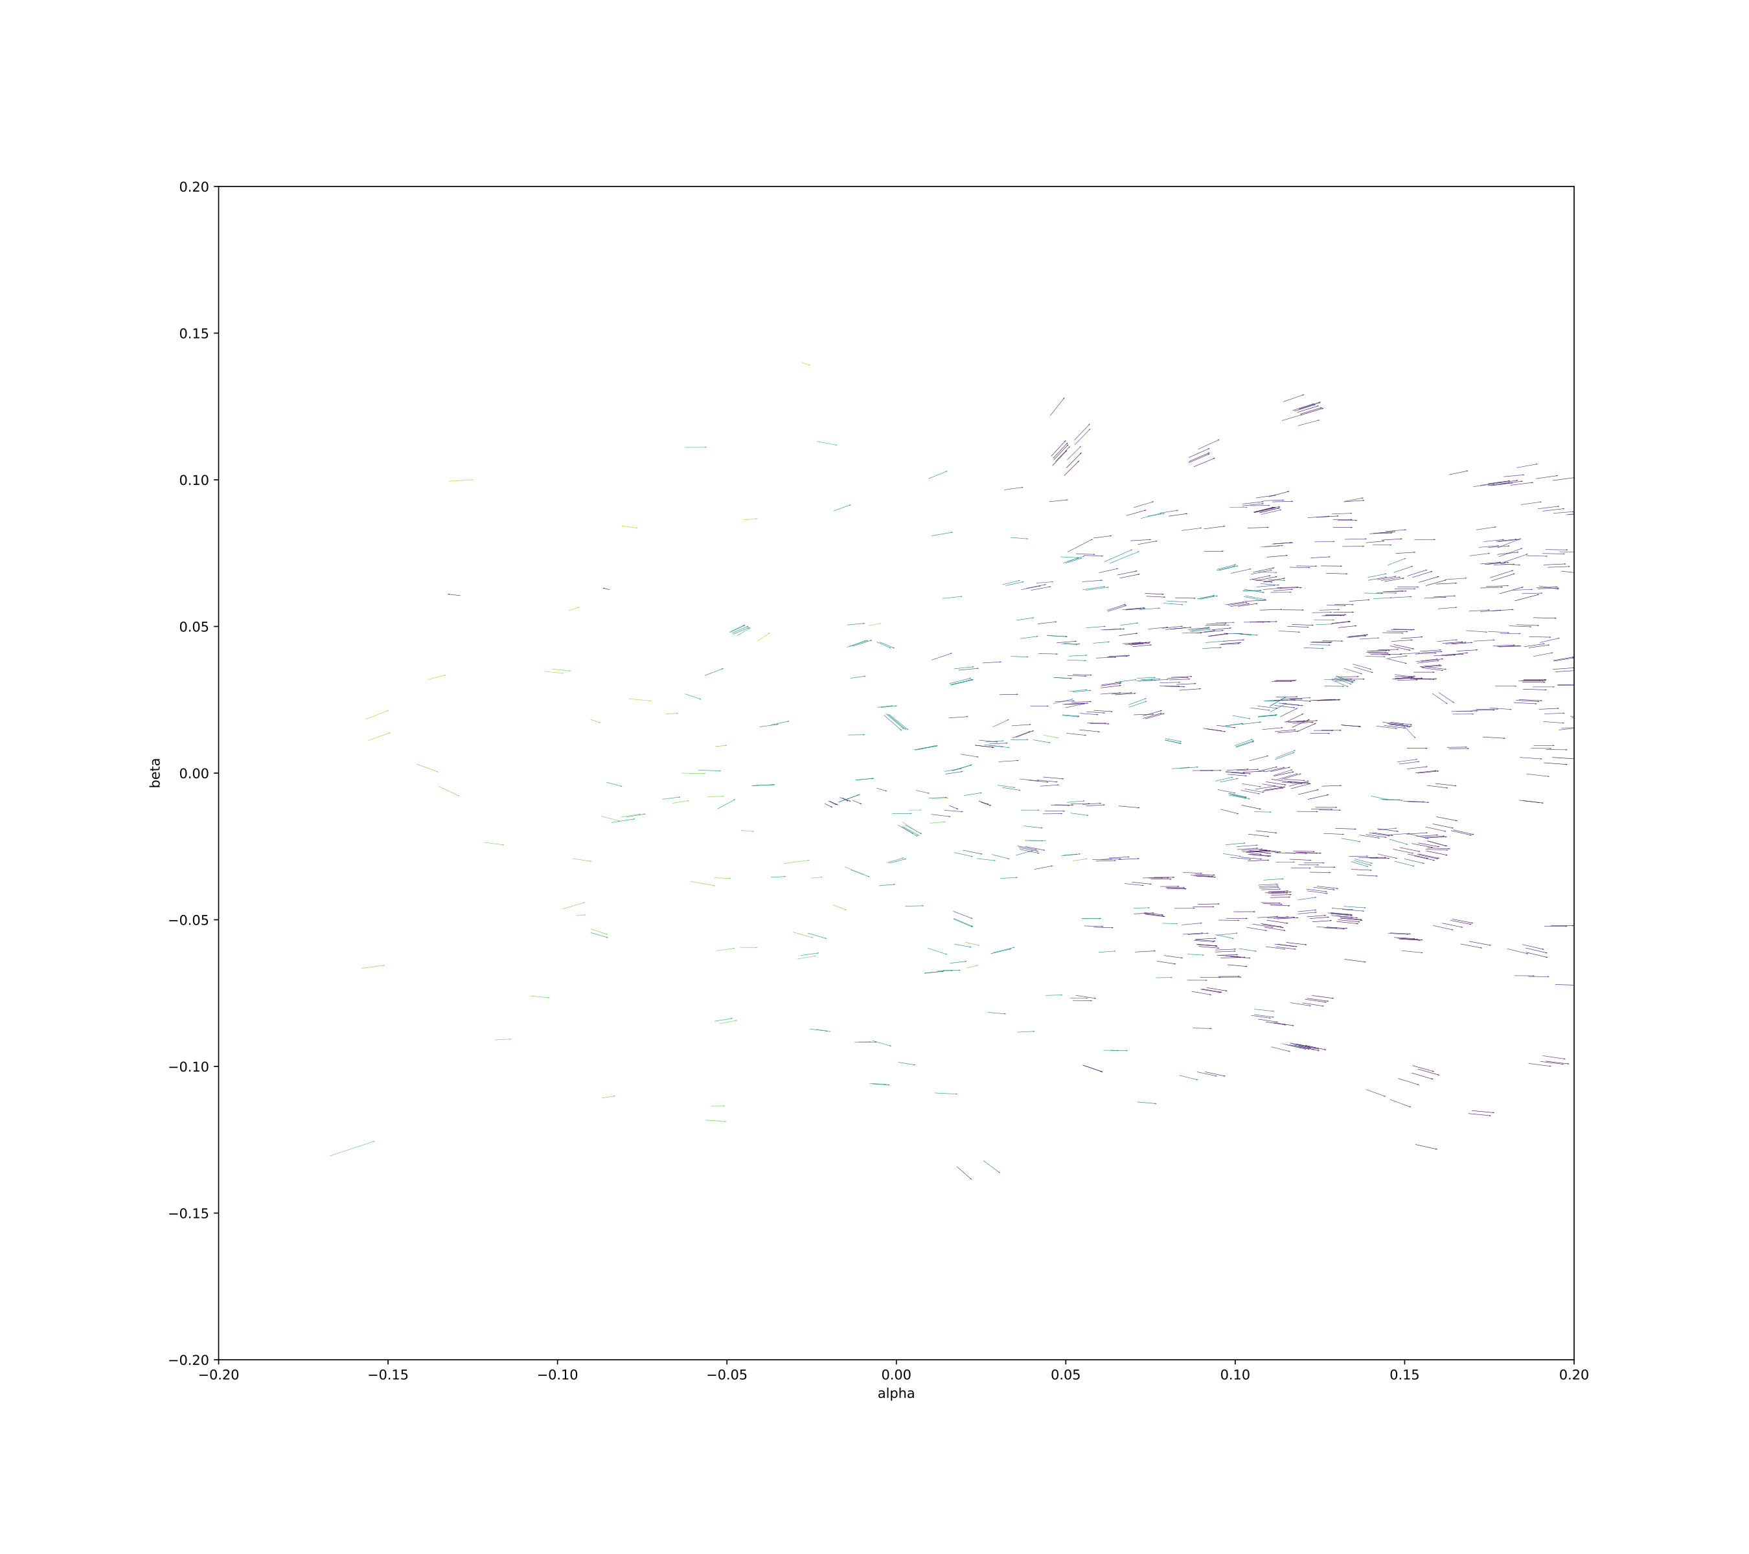
THE VIEW FROM THE SUN

Slide 12
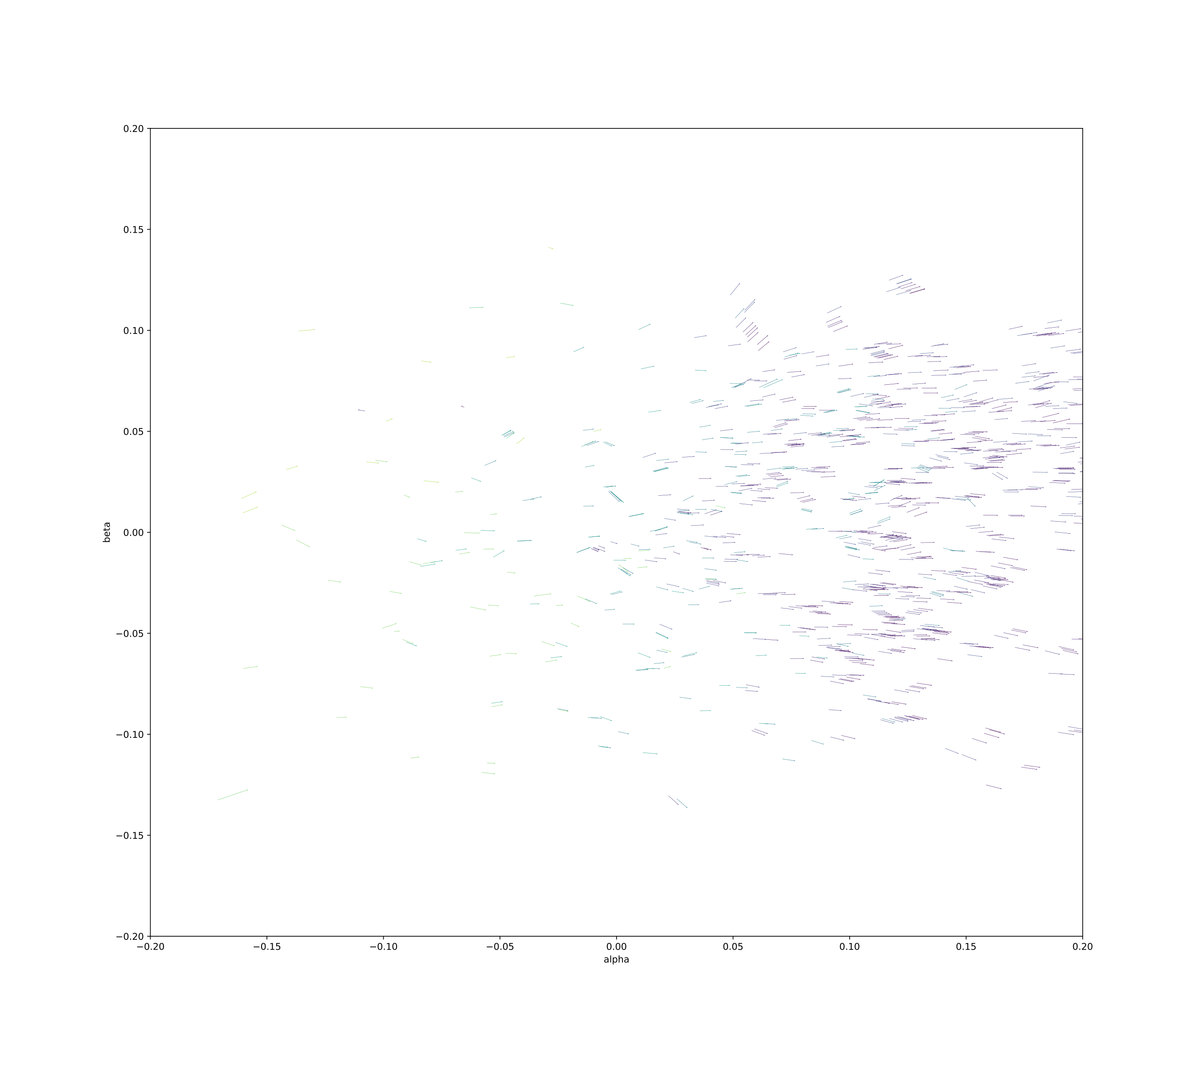
THE VIEW FROM THE SUN

Slide 13



CORE INTUITION
WHY DOES HELIOCENTRICITY WORK?
Heliocentric transform allows us to infer a constant distance from the sun
Also helps us compare asteroid tracklets linearly, and in common time
Enables clustering over small radii
Earth POV (nonlinear)
unknown
unknown, but:
inferable
~constant
Heliocentric POV (~linear)
known
*not to scale
(…obviously)

Slide 14
OUR METHODOLOGY
Running full sky in a single cluster is computationally intractable [O(n log n)]
1.
DIVIDE SKY INTO !!! PLANES
AND 300 TIME SLICES
2.
ASSERT THE (UNKNOWN)
Z-DISTANCE FROM THE SUN

Slide 15
OUR METHODOLOGY
1.
DIVIDE SKY INTO !!! PLANES
AND 300 TIME SLICES
4 of our 6 motion parameters are known, and 1 is relatively constant
Model is linear in the parameters
2.
ASSERT THE (UNKNOWN)
Z-DISTANCE FROM THE SUN
ITERATE OVER Z-VELOCITIES, SOLVE OTHER MOTION PARAMS
3.
CLUSTER BASED ON 6 PARAMS: X/Y/Z POSITION, X/Y/Z - VELOCITY
4.

Slide 16
OUR METHODOLOGY
TUNE CLUSTERING HYPERPARAMETERS OVER KNOWN TRAINING SET (THANKS TO MINOR PLANET CENTER!)
TRAIN CLUSTER RADIUS/WEIGHTING
1.
DIVIDE SKY INTO !!! PLANES
AND 300 TIME SLICES
We tune two hyper-parameters:
1) OPTIMAL
CLUSTER RADIUS
2) WEIGHTING OF
VELOCITY VS.
POSITION
2.
ASSERT THE (UNKNOWN)
Z-DISTANCE FROM THE SUN
3.
ITERATE OVER Z-VELOCITIES, SOLVE OTHER X/Y MOTION PARAMS
CLUSTER BASED ON 6 PARAMS: X/Y/Z POSITION, X/Y/Z - VELOCITY
4.

Slide 17
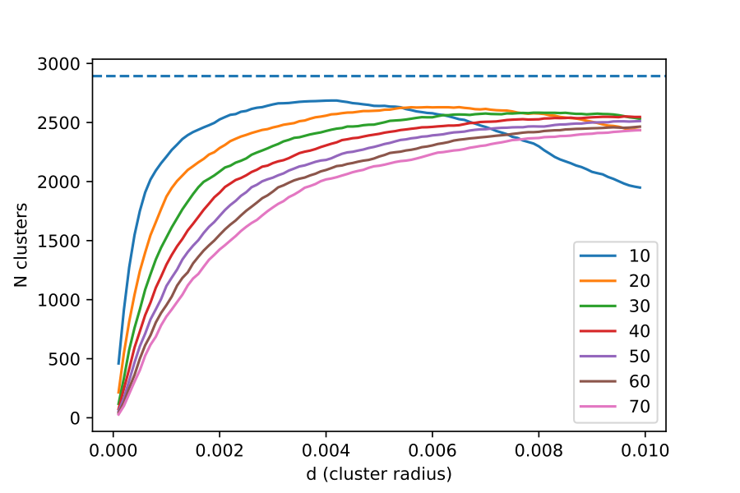
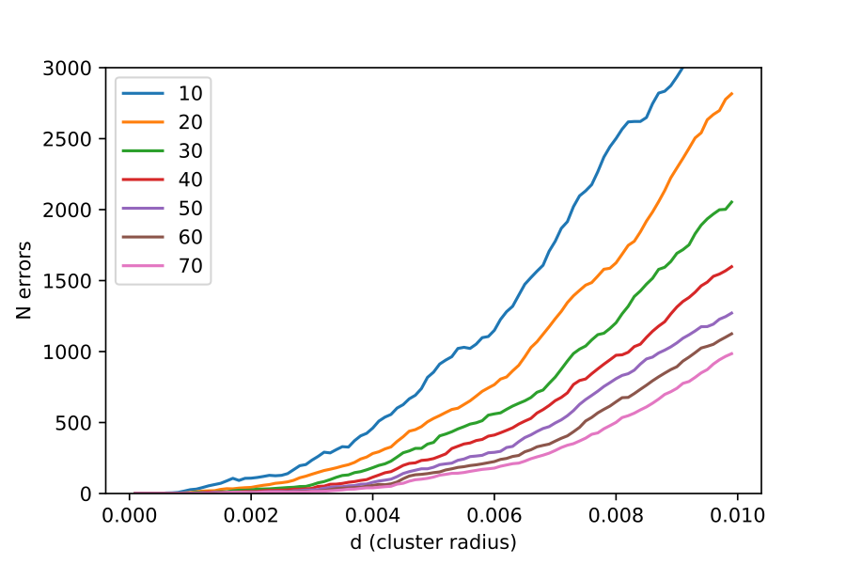
Total clusters detected vs. KD-tree cluster radius (training set)
TUNING PERFORMANCE
OPTIMAL CLUSTER
RADIUS: 0.005-0.010AU
Error rate vs. KD-tree cluster radius (training set)
Selected KD-tree clustering for optimal speed (!!!)
Also had good results with agglomerative clustering

Slide 18
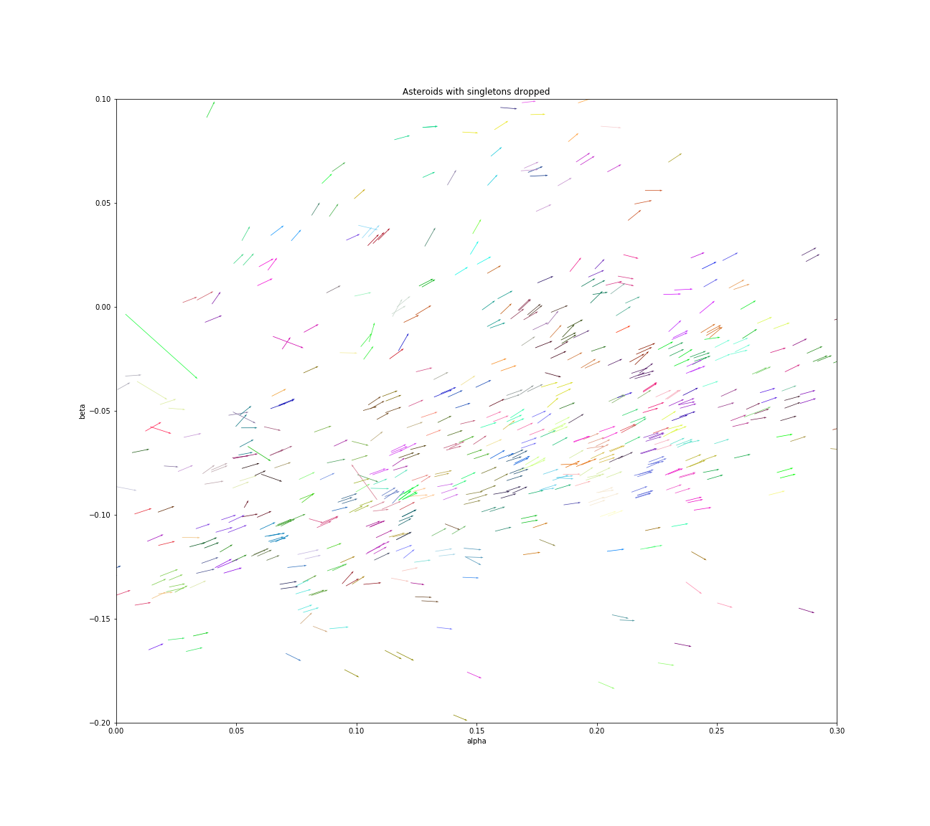
CLUSTERING RESULTS
90% OF ASTEROIDS DETECTED
WITH ZERO ERROR!
Identified Asteroids (common colors = a single asteroid)
!!! COPY HERE?

Slide 19

CONCLUSIONS
Conclusion: Successful tracklet matching using the heliocentric transform and KD-Trees
Also able to do so in just O(n log n) time, a scalable solution!!
Limitations: possible improvement in a more accurate clustering method
Next Steps: Run the algorithm over all 14m partial observations!
Thanks To: The Minor Planet Center for training data, Scott and Brian for project support!

Slide 20
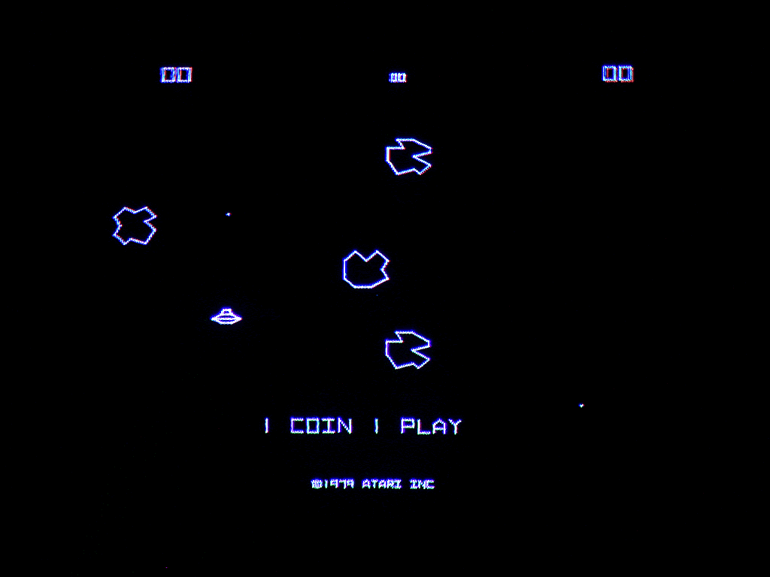

Slide 21

APPENDIX/SUPPORTING SLIDES

Slide 22
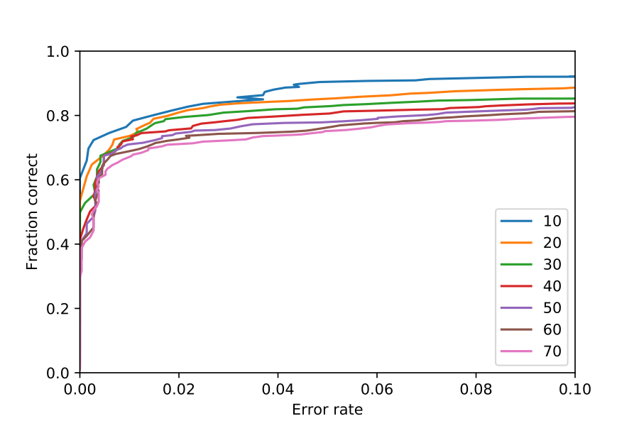
Training AUC

Slide 23
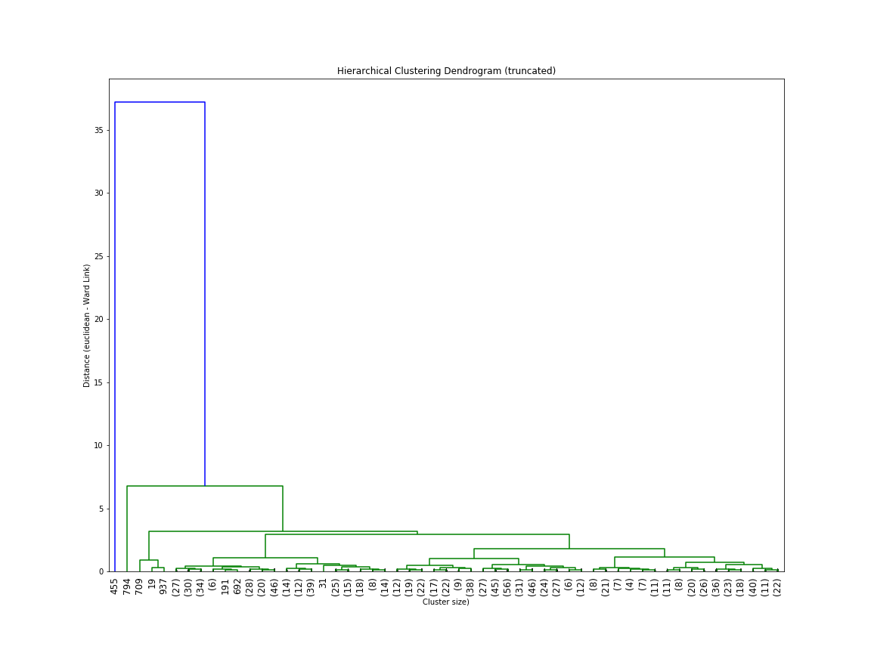
Agglomerative Clustering Dendogram (Truncated)

